Slide 1
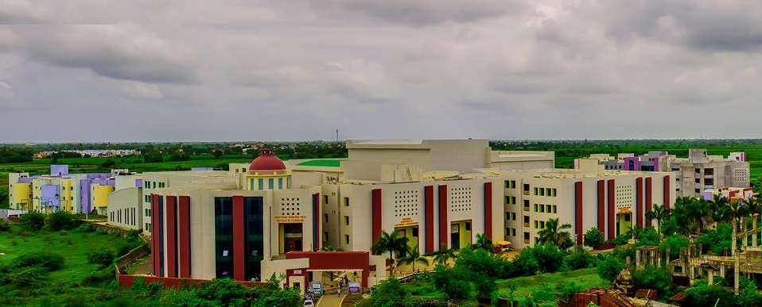
GUJCOST Sponsored
One-Day Workshop on
‘Water Harvesting and Groundwater Recharge Techniques’
25th March, 2022
NAAC Accredited
2.74, B⁺ Grade
Organized by:
Department of Civil Engineering
Chhotubhai Gopalbhai Patel Institute of Technology,
UKA Tarsadia University , Bardoli
Chief Patron:
Dr. Dinesh R. Shah
Provost UTU
Patron:
Dr. Manoj J. Gundalia
I/C Director, CGPIT
Convener:
Dr. Manoj J. Gundalia
Head, Department of Civil Engineering
********************
Co-Convener:
Dr. Vaibhav R. Pawar
vaibhav.pawar@utu.ac.in
Contact- 9408629954
Organizing Secretary:
Prof. Dimple J. Desai
dimple.desai@utu.ac.in
Contact- 9537568432

